Slide 1

Image classification – Vision TRansformer
Yuri Di Biasi

Slide 2
Vision Transformer
The Vision Transformer (ViT) is an Artificial Neural Network (ANN) architecture for Computer Vision for category-level recognition.
It can be seen as an extension of Convolutional Neural Networks (CNNs) with an arbitrarily large receptive field.

Slide 3
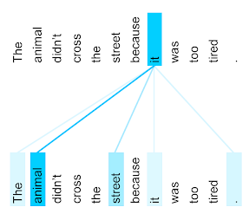
Attention
Attention is a mechanism for creating arbitrarily long-range weighted dependencies between word tokens in language models
If we can find a way to translate this tool to images, we can effectively find a way to replace/expand convolutions.

Slide 4
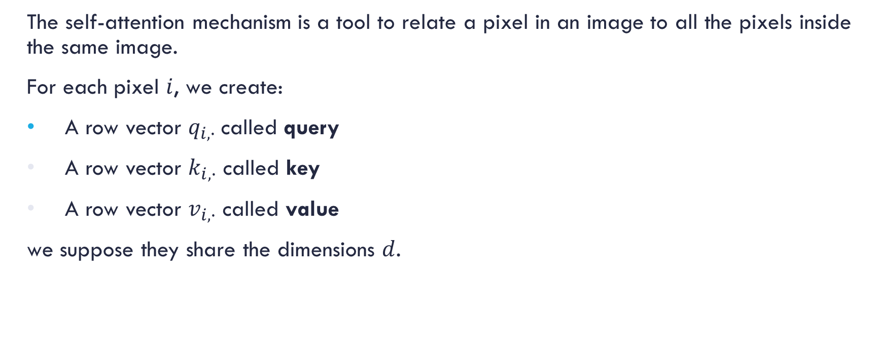
Self-attention
The self-attention mechanism is a tool to relate a pixel in an image to all the pixels inside the same image.
For each pixel $i$, we create:
A row vector $q_{i,∙}$called query
A row vector $k_{i,∙}$ called key
A row vector $v_{i,∙}$ called value
we suppose they share the dimensions $d$.
The query is matched to the keys in order to "return" the values

Slide 5
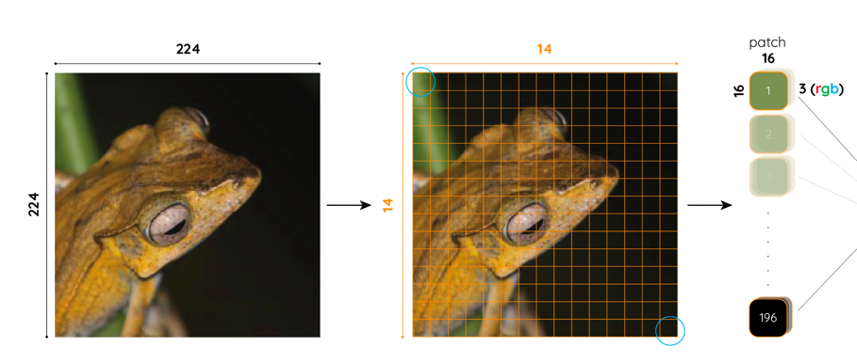
PATCH EMBEDDINGS
Image of size (3,224,224)
Divided into 196 (14x14) patches of size 3x16x16

Slide 6
PATCH EMBEDDINGS
Each patch is converted into a vector of size 3 x 16 x 16 = 768
After that, we have 196 vectors of size 768, a matrix of size (196, 768)

Slide 7
HOW GOOD IS VIT PERFORMANCE?
Worse than Resnet when trained just on ImageNet
Performance improved when pre-trained on very big dataset
Pretrained outperforms much bigger CNNs

Slide 8

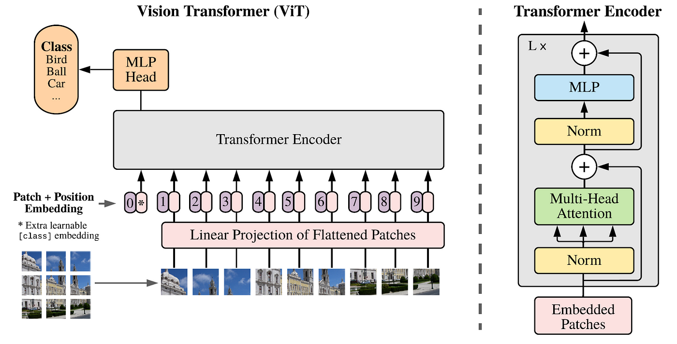
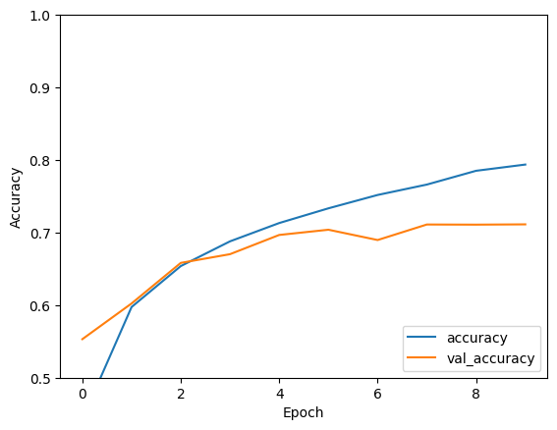
Results
Dataset
Model
Accuracy
1200 images
90% train – 10% test
vit_b_16 (patch 16x16) trained - pytorch
70% after 10 epochs

Slide 9
Thank you for your attention

